Slide 1
IMAGE CAPTION GENERATOR
USING NEURAL NETWORKS

Slide 2
MOTIVE
Our motive is to generate accurate and relevant captions for images.
Because it can aid visually impaired individuals in understanding the content of images.
Improve search engine results and
Enhance the overall user experience in applications that utilize images.

Slide 3
STAGES
The project goes under several phases of Data Analysis
1. Data Collection
2. Data Exploration
3. Data Pre-processing
4. Feature Extraction
5. Training Model
6. Testing Model and Evaluation

Slide 4
DATA COLLECTION
The main motivation behind data collection is to gather information in a measured and systematic manner to ensure accuracy.
Since the data collected is meant to provide content for data analysis, the information gathered must be of the highest quality for it to be of value.
There is a lot of data being generated all around the world, but the most important part is knowing how to utilize it.

Slide 5
DATA COLLECTION PROCESS
The data collection process for this project involved downloading the Microsoft Common Objects in Context (COCO) dataset, which contains over 330,000 images with more than 2.5 million captions. Specifically, the "train2014" subset of the dataset was used, which contains approximately 83,000 images.

Slide 6
Data Exploration
Data Exploration in this project involves two main categories.
Visualizing Images: Visualizing a sample of images from the dataset provides an initial glimpse into the nature of the data.
Exploring Captions: Analyzing the captions provides insights into the language used, caption lengths, vocabulary size, and distribution of captions across images.

Slide 7
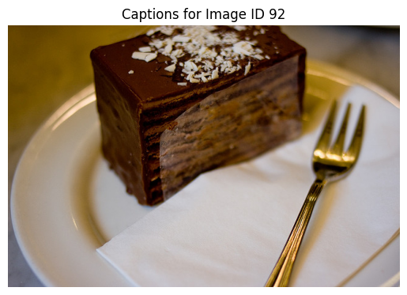
A white plate with a brownie and white frosting.
A piece of chocolate cake on top of a white plate.
a chocolate cake and a fork ready to be eat
A chocolate desert on a plate with a fork.
A piece of chocolate dessert on a plate with a napkin and a fork.

Slide 8
Data Pre-processing
Data Pre-processing in this project involves two main categories.
• Pre-processing the text data: The captions were pre-processed to remove any unnecessary characters, convert all characters to lowercase.
• Tokenizing the captions: The captions were tokenized using the Tokenizer class from the Keras library. This involved creating a vocabulary of all the unique words in the captions and assigning a unique integer to each word.
• Creating the training dataset: The pre-processed image features and tokenized captions were combined to create the training dataset. The model was trained on this dataset to learn to generate captions for images.

Slide 9
Feature Extraction
In this project, the VGG16 model is used to extract features from the images. VGG16 is a pre-trained convolutional neural network that is widely used for image classification tasks
To extract features, first, each image is resized to (224, 224) pixels, which is the required input size of the VGG16 model.
Then, the pre-trained VGG16 model is used to predict the output for each image.
The extracted features are then saved in a dictionary where the key is the image filename
This dictionary is used later to train the caption generator model.

Slide 10
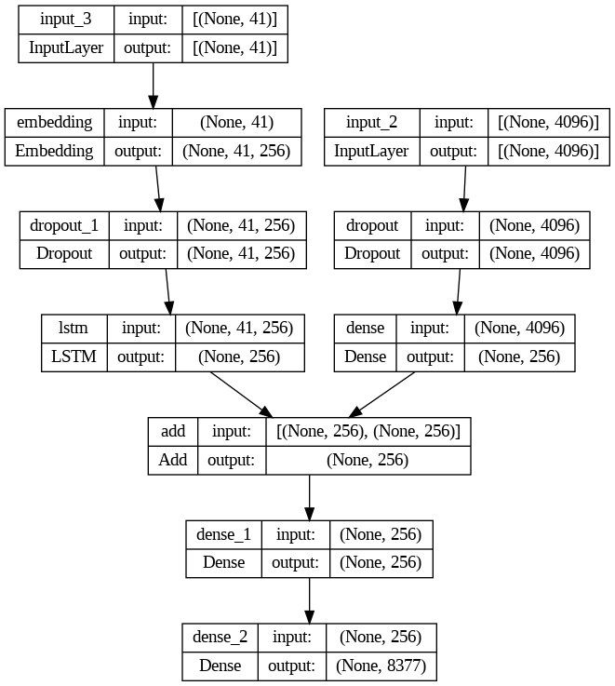
TRAINING MODEL
1. Model Architecture
2. Data Preparation
3. Model Training
4. Batch Training
5. Training Parameters

Slide 11
Testing Model and Evaluation
To test the trained model, we use a separate test set of image-caption pairs that were not used during training.
For each image in the test set, we generate a predicted caption using the trained model and compare it to the actual captions using the BLEU score.

Slide 12
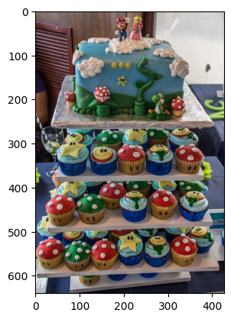
Below is the caption generated for an image from the dataset along with their actual captions.
---------------------Actual---------------------
racks of cupcakes with cake on the top.
many colorful cupcakes are stacked below similar cake.
cake with multiple platforms with cupcakes on them
very well constructed mario cake with cupcakes.
cake and several cupcakes are being displayed.
--------------------Predicted--------------------
child's room with cakes and cupcakes on it

Slide 13
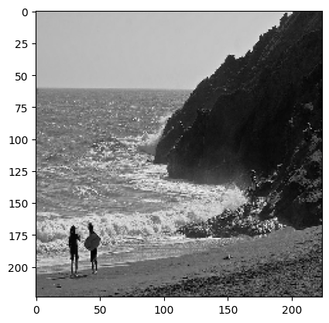
Predicted Caption Of A New Image
‘man walking on the beach with surfboard’

Slide 14
Future Scope
Multilingual image captioning
Video captioning
Contextual image captioning
Image captioning for the visually impaired
Image search engine

Slide 15
CONCLUSION
Overall, the evaluation report provides a comprehensive view of how well the trained model performs on the test set.
The BLEU scores give us a quantitative measure of the model's performance
The visual inspection allows us to get a qualitative sense of how well the model is able to generate captions.
Based on these metrics, we can determine whether the model needs further refinement or if it is ready for deployment.

Slide 16
THANK YOU

